Slide 1
Python Web Frameworks: Django vs FastAPI
A Beginner's Guide to Modern Web Development
Notes:
"Good morning/afternoon everyone! Welcome to our session on 'Python Web Frameworks: Django vs FastAPI.' I'm Jeryl Estopace, a Software Engineer at LawAdvisor Ventures, and I'm excited to share with you today how these powerful web frameworks can jumpstart your development journey."
"Before we start, I'm curious - how many of you have used Python before? And how many have built any kind of web application? [Wait for hands to be raised] Great! No matter your experience level, today's presentation is designed to give everyone a clear understanding of these frameworks."
"Web frameworks are essential tools for modern developers. They're like specialized toolkits that help us build websites and web applications more efficiently. Today, we're going to compare two of the most important Python frameworks - Django, which is comprehensive and feature-rich, and FastAPI, which is newer and focuses on performance."
"By the end of this session, you'll understand the strengths of each framework and be able to make informed decisions about which one might be right for your projects. We'll even look at real job listings that require these skills right here in the Philippines, so you can see how learning these frameworks might benefit your future careers."
"Let's get started with an overview of what we'll cover today."

Slide 2
Presentation Overview
About Me & My Journey
Web Development Basics
Python Web Framework Landscape
Django: The Complete Package
FastAPI: The Speed Champion
Live Demo Comparison
Career Opportunities in the Philippines
Which Framework Should You Choose?
Resources & Getting Started
Q&A
Notes:
"Here's our roadmap for today's presentation. We have quite a bit to cover, but I've structured it to build your understanding step by step."
"We'll start with a bit about my background and journey from accounting to software engineering. I believe this will show you that tech careers are accessible even if you don't have a traditional computer science background."
"Next, we'll cover some web development basics - how websites actually work behind the scenes. This foundation will help you better understand why frameworks are so useful."
"Then we'll explore the Python web framework landscape to see where Django and FastAPI fit in the bigger picture."
"The core of our presentation will be deep dives into both Django and FastAPI. For Django, we'll look at its 'batteries-included' approach that gives you everything you need out of the box. For FastAPI, we'll explore its speed and modern design that makes it perfect for building APIs."
"One of the highlights will be our live demo comparison where I'll show you the same application built in both frameworks so you can see the differences in action."
"We'll also look at career opportunities right here in the Philippines, with real salary ranges and job requirements I've found on JobStreet."
"By the end, you'll have enough information to decide which framework might be best for your specific needs, and I'll share resources to help you get started with either one."
"Throughout the presentation, feel free to raise your hand if you have questions. I'll also save time at the end for a more extended Q&A session."
"Any questions about our agenda before we dive into my background? [Pause for questions] Great, let's continue!"

Slide 3
About Me: From Accounting to Software Engineering

Slide 4

About Me: From Accounting to Software Engineering
Background & Education:
BS in Accountancy from Laguna University (2012)
Pursuing Graduate Diploma in Computer Science (UP Open University)
Started in finance at JPMorgan Chase (Financial Reporting for BlackRock funds & Alternative Investments Bank Loans)
Career Evolution:
Financial Software Support (SS&C Advent)
Technical Support Engineer (Oracle NetSuite)
Junior Software Engineer (PDAX) - Cash in/Cash out payment systems for cryptocurrency exchange
Mid Software Engineer (LawAdvisor Ventures) - Legal technology solutions
Elixir/Phoenix Developer (AllocatorOne) - Financial technology for venture capital
Notes:
"Before we dive into the technical details of Django and FastAPI, I'd like to share a bit about my background because it might surprise you. Like many of you, I didn't start my career in computer science or software engineering."
"I graduated with a BS in Accountancy from Laguna University in 2012 and started my career in the finance sector at JPMorgan Chase. There, I worked on financial reporting for BlackRock funds and was part of the trades team for alternative investments bank loans. This experience gave me valuable insights into financial systems and processes."
"My journey into programming wasn't traditional. I moved into financial software support at SS&C Advent, where I got to see how financial technology systems work from the inside. This hands-on experience with enterprise software sparked my curiosity about how these systems were built."
"From there, I became a Technical Support Engineer at Oracle NetSuite, diving deeper into the technical side of business software. This role became my bridge into actual software development, showing me that understanding business problems is just as important as knowing how to code."
"I then made the full transition to software engineering at PDAX, where I worked on cash in/cash out payment systems for their cryptocurrency exchange. This was my first opportunity to build critical financial infrastructure from the ground up."
"Most recently, I've been a Mid Software Engineer at LawAdvisor Ventures, developing legal technology solutions. And I'm excited to share that this Friday is actually my last day there before I start a new position as an Elixir/Phoenix Developer at AllocatorOne, where I'll be building financial technology for venture capital.”
"Throughout this journey, I've been pursuing a Graduate Diploma in Computer Science at UP Open University to formalize my technical knowledge."

Slide 5
About Me: From Accounting to Software Engineering
Technology Experience:
Languages: Elixir, JavaScript, TypeScript, Dart, Python
Backend: Phoenix Framework, Node.js
Frontend: Phoenix LiveView, React, Flutter
Databases: PostgreSQL
Cloud/DevOps: AWS, GCP, Docker
Development Environment: Neovim (previously VS Code)
Teaching Experience:
Conducted 1-week Flutter mobile development training for PCHRD-DOST researchers (2019)
Notes:
"Over the years, I've developed expertise across various technologies. In terms of programming languages, I work with Elixir, JavaScript, TypeScript, Dart, and Python."
"On the backend, I specialize in Phoenix Framework and have experience with Node.js. For frontend development, I work with Phoenix LiveView, React, and Flutter."
"My database experience is primarily with PostgreSQL, and I've worked with AWS, GCP, and Docker for cloud and DevOps functions."
"Interestingly, my development environment has evolved too. I previously used VS Code but have transitioned to Neovim as my primary editor."
"Beyond building software, I've had the opportunity to share knowledge with others. In 2019, I conducted a one-week intensive Flutter mobile development training program for researchers at PCHRD-DOST. This teaching experience reinforced for me how important it is to understand fundamentals before diving into specific frameworks."
"The reason I'm sharing my journey with you is that it demonstrates something important: your path into tech doesn't have to be linear. Your diverse interests and backgrounds are actually advantages that can set you apart in the field."
"Web frameworks like Django and FastAPI, which we'll be exploring today, can be your gateway into tech careers, even if you're not a computer science major. They're powerful tools that companies actually use to build real products, and mastering them can open similar doors for you as they did for me."
"Now, let's explore how these web frameworks can be part of your journey by first understanding the basics of web development."

Slide 6
Web Development Fundamentals

Slide 7
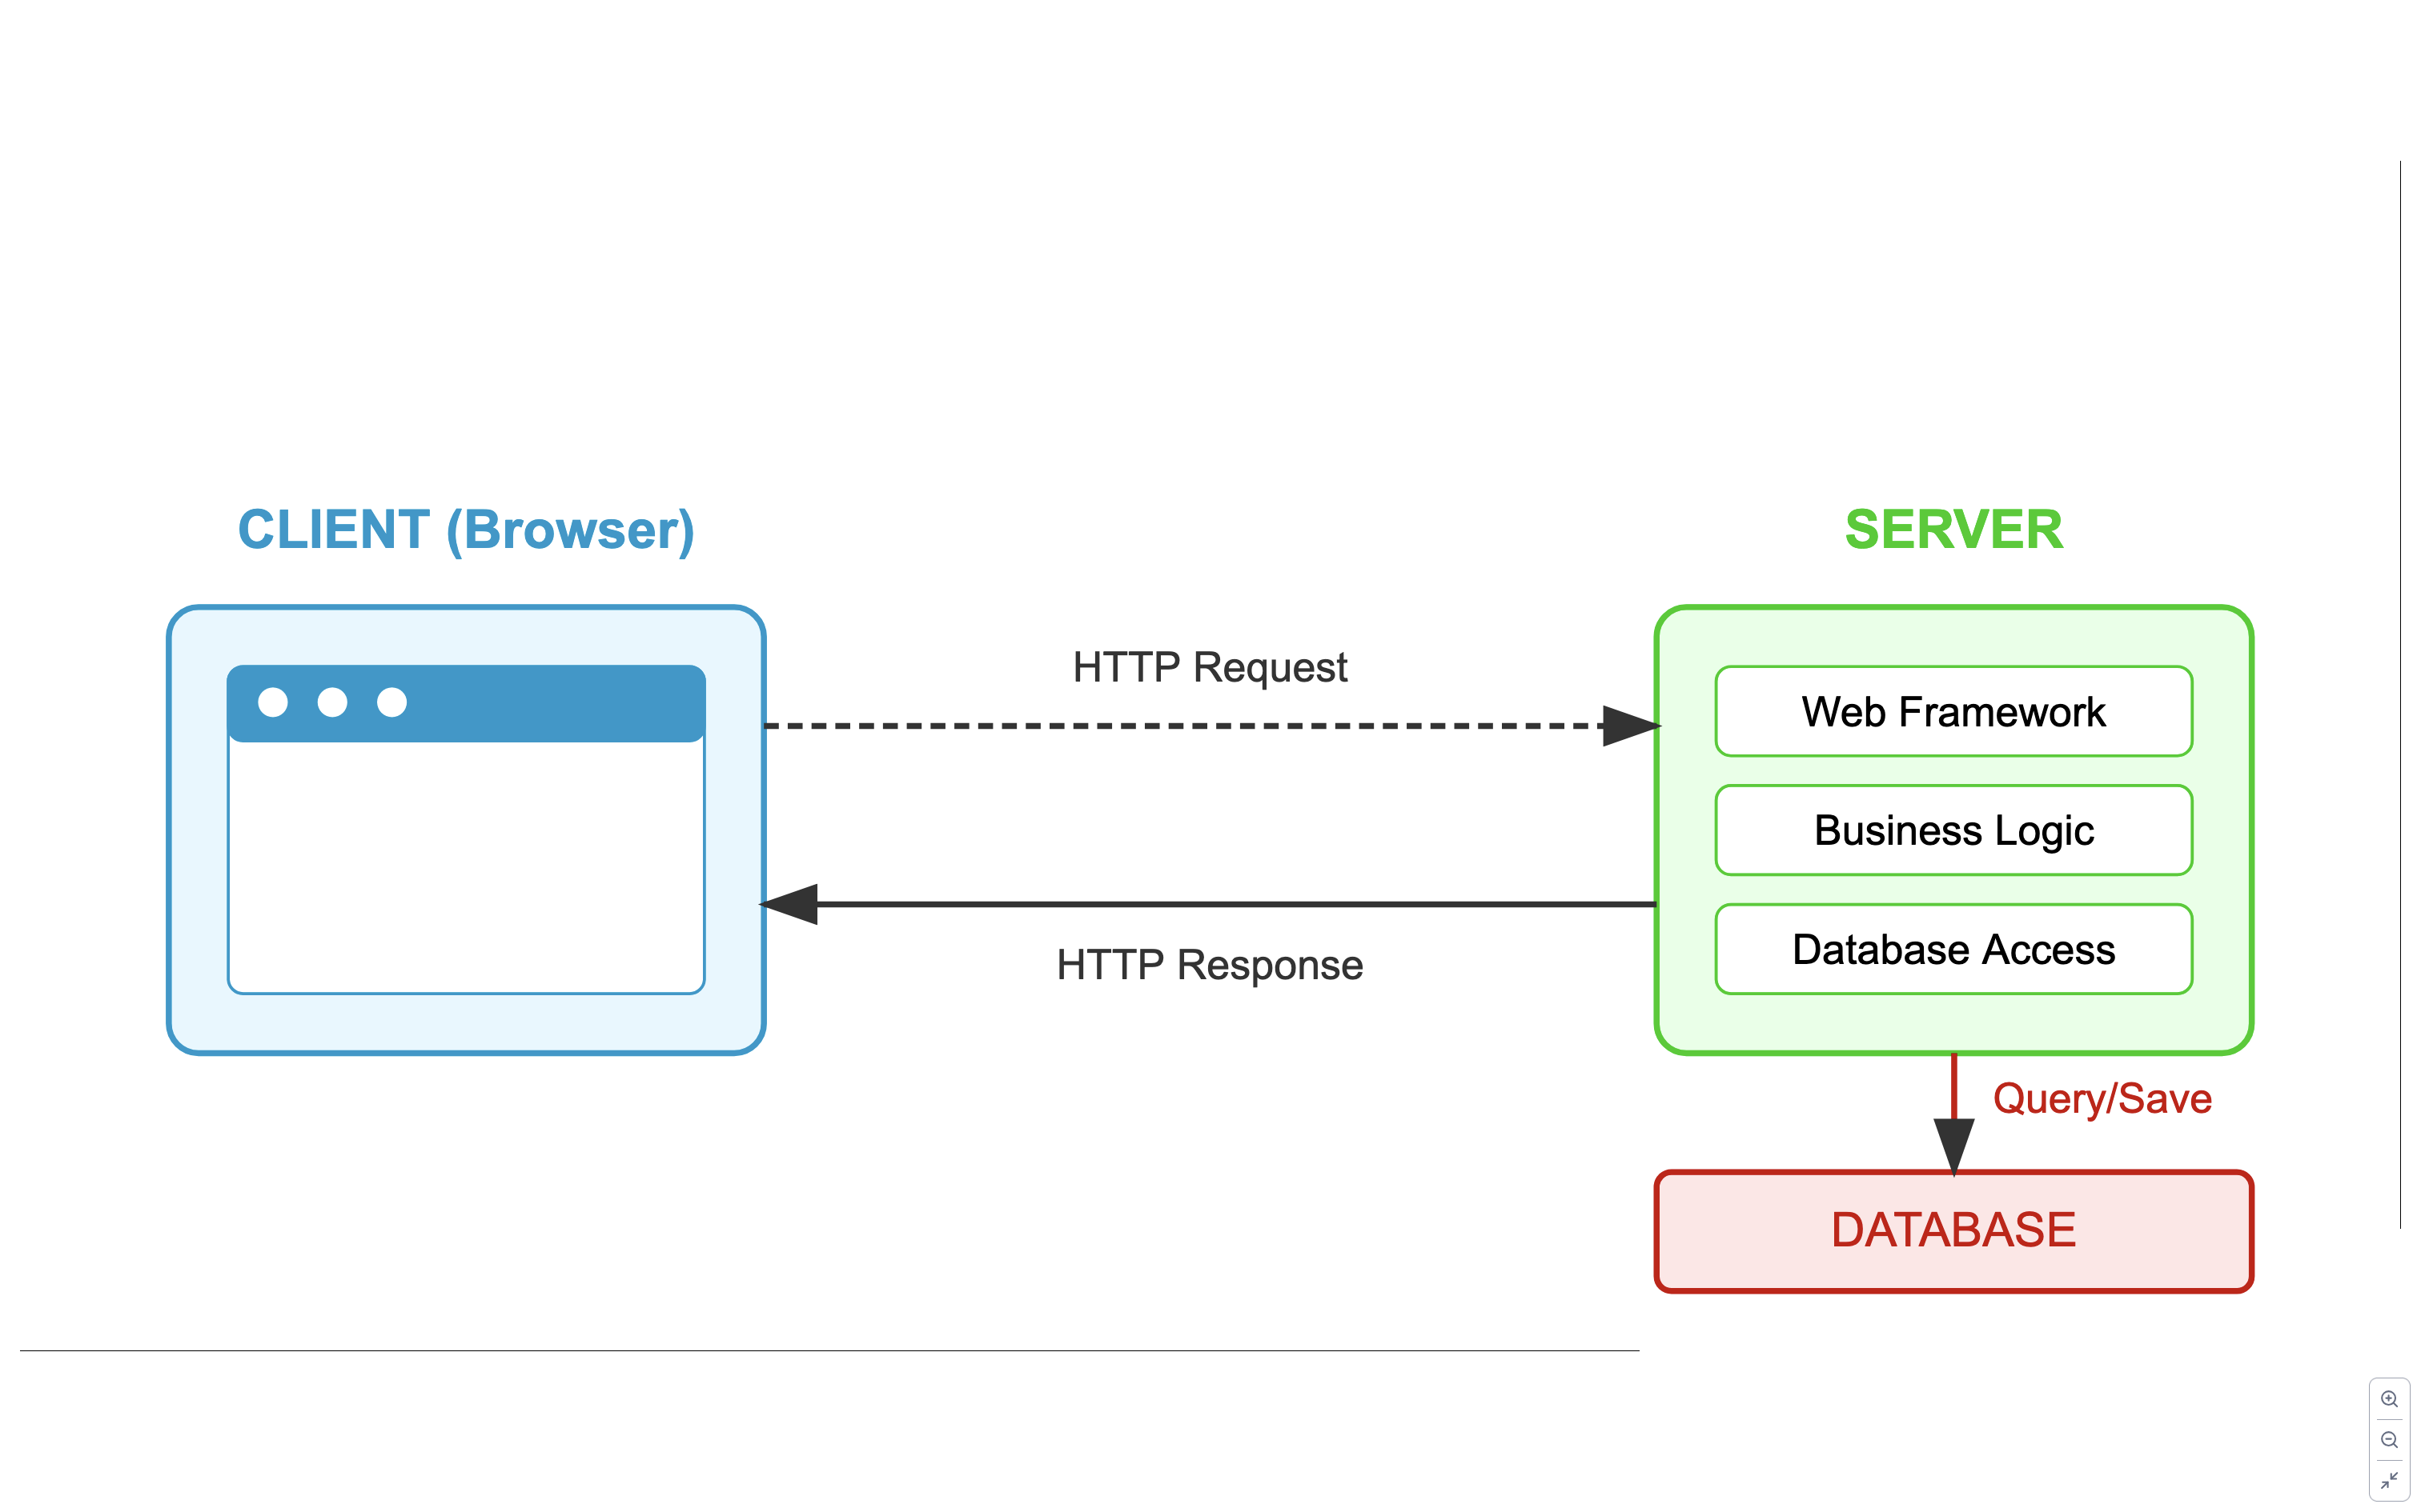
Web Development Fundamentals
Notes:
"Let's start by understanding the foundation of web development. This diagram shows the basic architecture that powers virtually every website and web application you use.”
"Looking at this architecture diagram, here's a challenge question: In a modern web application, what specific technologies might be running on the server to process these HTTP requests? Name at least two specific web technologies or languages that could power the server component.”
[Wait for responses - looking for answers like Python, Django, FastAPI, Node.js, PHP, Ruby on Rails, ASP.NET, Java Spring, etc.]
"Great answers! Yes, there are many technologies that can power the server side, including Python frameworks like Django and FastAPI which we'll be focusing on today. The server layer is where developers have the most choices to make, and that's why understanding the differences between frameworks is so important."
"Now let's walk through how these components interact. The client—your web browser—sends HTTP requests to a server whenever you click a link, submit a form, or type a URL. The server, which might be running Django or FastAPI, processes these requests by executing code that implements business logic."
"During this processing, the server often needs to retrieve or store data, which is where the database comes in. The server queries the database, gets the information it needs, and then formulates an HTTP response to send back to the client browser."
"This response typically contains HTML, CSS, and JavaScript that your browser renders into the webpages you see and interact with. The entire process happens in milliseconds, and it repeats every time you interact with a web application."
"This request-response cycle is fundamental to understanding how web frameworks operate. The frameworks we'll discuss today—Django and FastAPI—both handle this process but with different philosophies and approaches."
"In the next slide, we'll dive deeper into the components of web development and why frameworks are so valuable for developers."

Slide 8
Web Development Fundamentals
Client-Server Architecture:
Client (browser) sends requests to server
Server processes requests and returns responses
Communication happens via HTTP protocol
The Web Stack:
Frontend: What users see and interact with (HTML, CSS, JavaScript)
Backend: Server-side logic, database interactions, authentication
Database: Stores and manages application data
Why We Need Frameworks:
Provides structure and organization for code
Handles common tasks (routing, database access, authentication)
Implements security best practices automatically
Speeds up development with reusable components
Notes:
"Now that we understand the basic architecture, let's discuss why web frameworks are so important in modern development."
"Web development involves working with multiple layers of technology, often called 'the stack.' The frontend is what users see and interact with—built with HTML, CSS, and JavaScript. The backend is the server-side logic that processes requests, implements business rules, and interacts with databases. The database layer stores all the application data in a structured and retrievable way."
"When you're building a web application, you face many common challenges: How do you handle user authentication securely? How do you structure your database queries efficiently? How do you route incoming requests to the appropriate handling code? How do you validate form inputs to prevent security vulnerabilities?"
"This is where web frameworks become invaluable. Instead of solving these problems from scratch every time, frameworks provide tested, optimized solutions that you can implement with minimal code."
"Frameworks like Django and FastAPI give you a structured way to build applications. They handle common tasks like URL routing, database access, and user authentication, allowing you to focus on what makes your application unique."
"Think of a web framework like a starter kit for building a house. Instead of manufacturing bricks, designing plumbing systems, and wiring electrical circuits yourself, you get pre-designed components that are known to work well together. You still decide what the final house looks like and how it functions, but you save tremendous time and effort by not starting from raw materials."
"The choice of framework significantly impacts how you'll build your application, how fast it will run, how easy it will be to maintain, and how quickly you can develop new features. That's why understanding the differences between Django and FastAPI is so important for your future projects."
"Now that we understand the basics, let's look at how Python has become a major player in web development and explore the current landscape of Python web frameworks."

Slide 9
Python Web Framework Landscape

Slide 10
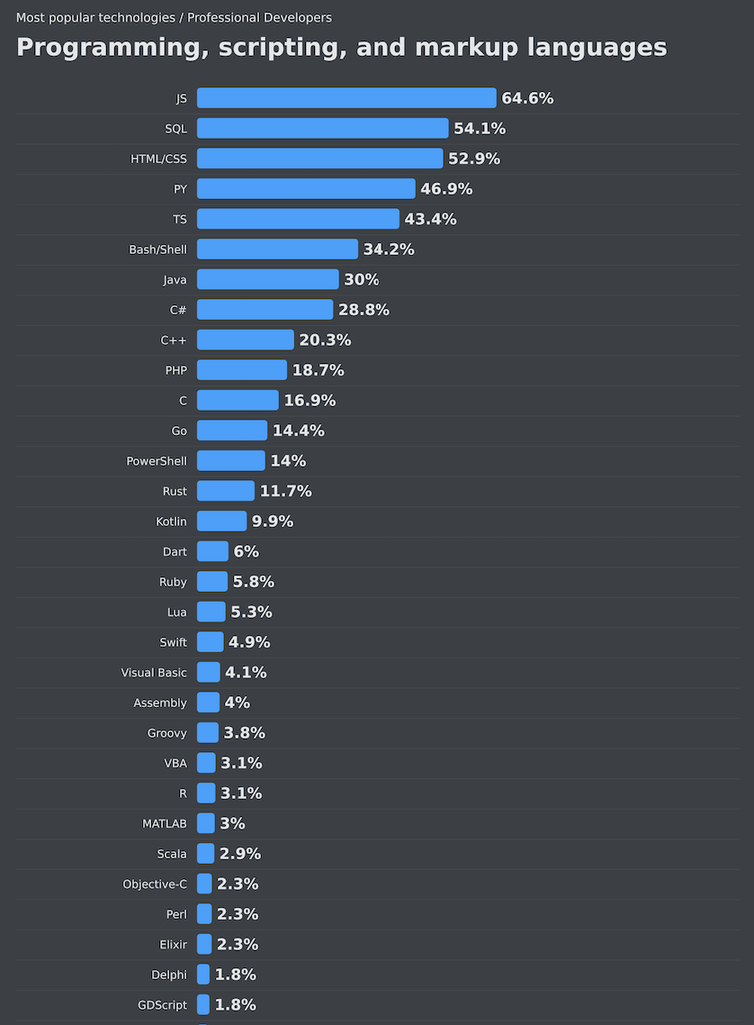
Python Web Framework Landscape
Among top 3 languages for web development
46.9% of professional developers use Python (Stack Overflow 2024)
Versatile across data science, AI, and web development
Popular for readability and extensive libraries Growing ecosystem of web frameworks
Notes:
"Now that we understand the basics of web development, let's look at where Python fits in this landscape."
"Python has emerged as one of the top three languages for web development globally. According to the Stack Overflow Developer Survey 2024, which you can see in this chart, nearly 47% of professional developers use Python regularly. This makes it an excellent language to invest your time in learning."
"What makes Python so popular for web development? First, its readable syntax makes it accessible for beginners while still powerful enough for experts. Second, its extensive standard library and third-party packages let you accomplish complex tasks with minimal code. Finally, Python's versatility means skills you learn for web development can transfer to data science, AI, automation, and many other fields."
"Python's position as the 4th most used programming language globally means there's a strong community, plenty of learning resources, and abundant job opportunities."
"Let me ask you: Has anyone here used Python before, and if so, what did you use it for? [Wait for responses]"
"Great insights! As we can see, Python serves many purposes, and web development is one of its strongest domains. Now, let's look specifically at the web framework options Python offers."

Slide 11
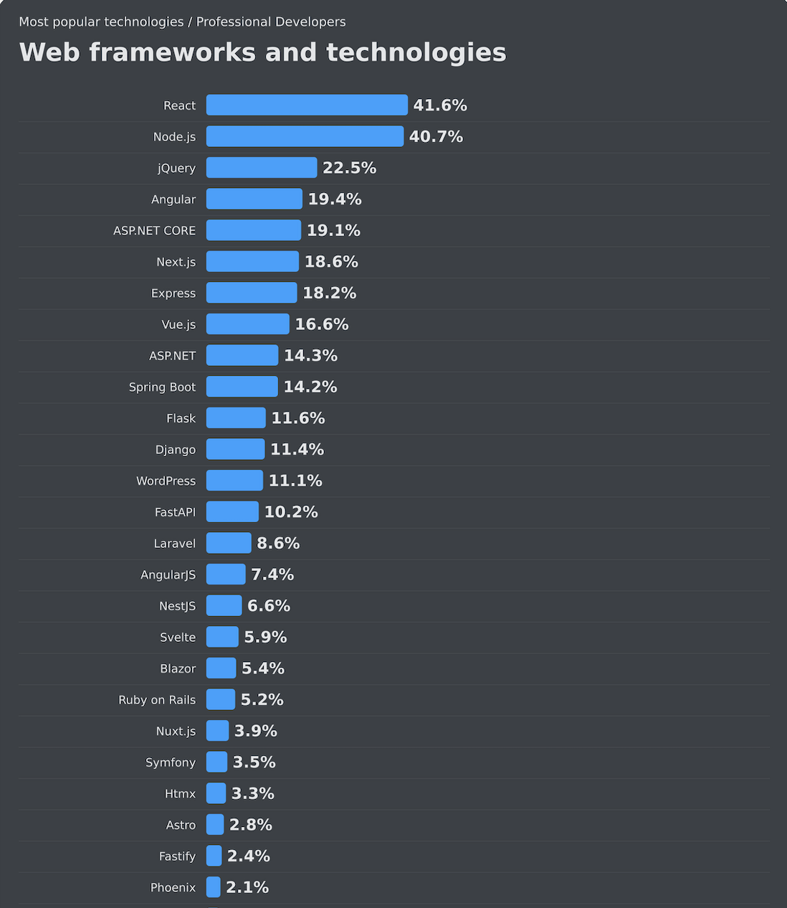
Python Web Framework Landscape
Most Popular Python Web Frameworks:
Django (11.4%): Full-featured, "batteries included"
FastAPI (10.2%): Modern, high-performance, API-focused
Flask (11.6%): Lightweight, flexible microframework
Framework Comparison:
Django: Established ecosystem (since 2005), used by Instagram, Pinterest
FastAPI: Fastest growing (since 2018), used by Netflix, Microsoft
Flask: Minimalist approach, popular for smaller projects
Notes:
"When it comes to building web applications with Python, developers typically choose from several frameworks. The three most popular are Django, FastAPI, and Flask, as shown in this Stack Overflow chart."
"Django has been around since 2005 and takes a 'batteries-included' approach, meaning it comes with almost everything you need built-in. It's used by major sites like Instagram, Pinterest, and Mozilla. About 11.3% of developers report using Django regularly."
"FastAPI is the newest of the three, launched in 2018, but it's also the fastest-growing. It focuses on building high-performance APIs with modern Python features. It's used by companies like Netflix, Uber, and Microsoft. The survey shows 10.9% of developers now use FastAPI, which is remarkable growth for a framework that's relatively new."
"Flask takes a minimalist approach, giving you just the basics and letting you add what you need. It's popular for smaller projects or when you want complete control over your components."
"Looking at this data, what surprises you most about the popularity of these Python web frameworks? [Wait for responses]"
"Those are interesting observations! What this tells us is that the web development landscape is constantly evolving. Django remains popular for its comprehensive approach, while FastAPI is gaining traction for its performance and modern features."
"Both frameworks frequently appear in job listings, as you'll see later in our presentation. They represent different philosophies in web development, and understanding both gives you flexibility in your career."
"Now, let's dive deeper into Django and see what makes this comprehensive framework so popular for building web applications."

Slide 12
Django: The Complete Package

Slide 13
Django: The Complete Package
What is Django?
"The web framework for perfectionists with deadlines"
Released in 2005, mature and battle-tested
Full-featured "batteries included" approach
Powers Instagram, Pinterest, Mozilla, Spotify
Core Philosophy:
Rapid development
Don't Repeat Yourself (DRY)
Explicit over implicit
Consistency and security by default
Notes:
"Let's dive into Django, which describes itself as 'the web framework for perfectionists with deadlines.' This tagline captures Django's core philosophy - it aims to provide a complete, polished solution that helps developers build applications quickly without sacrificing quality.
Django was first released in 2005, making it a mature and battle-tested framework with nearly two decades of development behind it. It powers major websites like Instagram, Pinterest, Mozilla, and Spotify, demonstrating its ability to scale to millions of users.
Django's philosophy centers around several key principles. First is rapid development - Django is designed to help you build applications quickly. Second is DRY, or 'Don't Repeat Yourself' - Django encourages code reuse to avoid redundancy. Third is 'explicit over implicit' - Django prefers clear, readable code over magic or hidden functionality. Finally, Django emphasizes consistency and security by default, which helps prevent common web vulnerabilities.
Django provides a comprehensive solution with everything included, which we'll visualize in the next slide."

Slide 14
Django: The Complete Package - Visual Metaphor

Slide 15
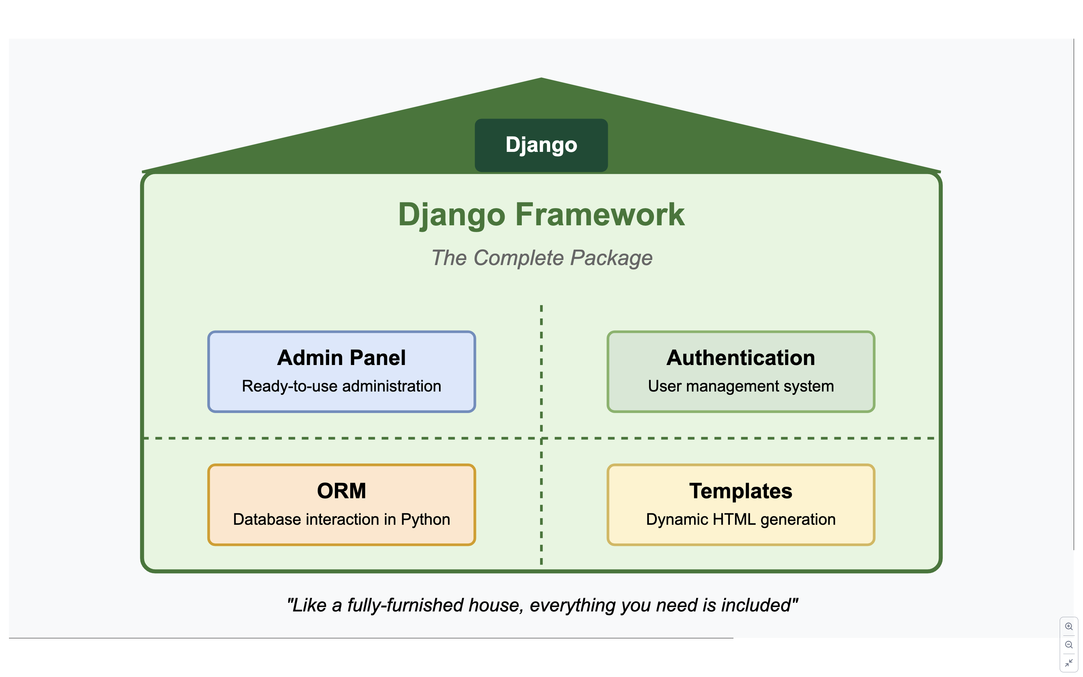
Notes:
"I like to think of Django as a fully-furnished house. When you move in, everything is already there - plumbing, electricity, furniture, and appliances. You might want to rearrange some things or add your personal touches, but you can start living there immediately without having to build basic infrastructure.
This 'batteries included' approach means Django comes with almost everything you need to build a complete web application. You don't need to make decisions about which library to use for common tasks - Django has already made those choices for you.
Looking at our metaphor here, you can see Django comes with a powerful admin panel that's automatically generated for your models. It includes a robust authentication system for user management. The ORM lets you interact with databases using Python instead of SQL. Form handling simplifies data validation and processing. Built-in security features protect against common vulnerabilities. And the template system generates dynamic HTML pages.
All of these components work together seamlessly, making Django particularly well-suited for projects where you need to build a complete web application quickly and securely.
Now, let's examine Django's architecture to understand how these components connect."

Slide 16
Django Architecture
Key Components:
Models: Define database structure using Python classes
Views: Handle business logic and control what users see
Templates: Generate HTML dynamically
Admin Interface: Auto-generated admin panel for content management
Forms: Handle user input with validation
ORM (Object-Relational Mapper): Interact with database using Python
Django's MVT Pattern:
Similar to MVC (Model-View-Controller) but with different terminology
Model: Data structure and database interactions
View: Business logic and request handling
Template: Presentation layer (HTML generation)
Notes:
"Django follows what's called the MVT (Model-View-Template) pattern, which is similar to the MVC (Model-View-Controller) pattern you might have heard of in other frameworks.
At the core of Django are Models, which define your database structure using Python classes. This means you don't have to write SQL - Django generates it for you. For example, if you're building a blog, you might have a Post model with fields for title, content, and publication date.
Views handle the business logic of your application. They receive web requests, interact with models to get or store data, and decide what to send back to the user. In our blog example, a view would handle retrieving all blog posts for the homepage.
Templates are Django's way of generating HTML dynamically. They're essentially HTML files with special tags that let you insert dynamic content. This separation of logic and presentation helps keep your code organized.
One of Django's most celebrated features is its automatic admin interface. With just a few lines of code, Django generates a complete admin panel where you or your content managers can create, view, update, and delete records in your database. This feature alone can save weeks of development time.
Django's Form system handles user input with built-in validation and security features. It helps prevent common security issues like cross-site request forgery and SQL injection.
The Object-Relational Mapper, or ORM, lets you interact with your database using Python instead of SQL. This abstraction makes your code more portable across different database systems and easier to read.
In the next slide, we'll see how all these components interact in a typical request-response cycle."

Slide 17
Django Request Flow

Slide 18
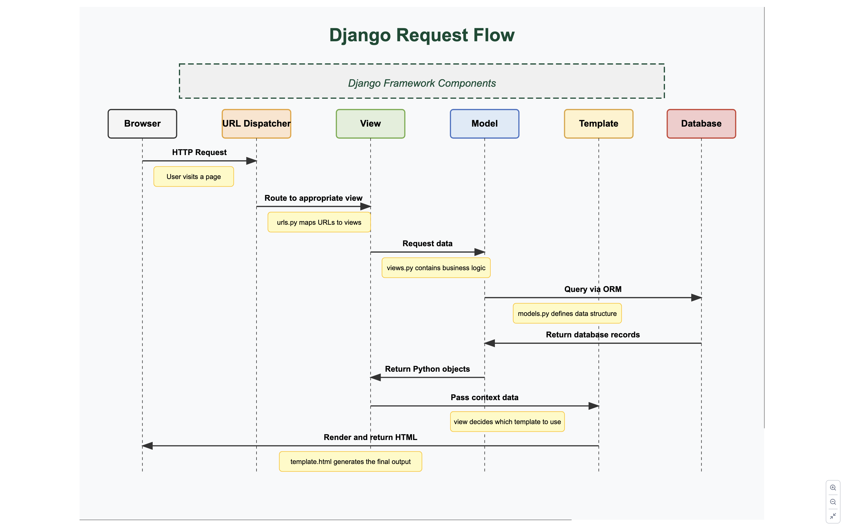
Notes:
"To tie it all together, let's look at how a request flows through Django. This diagram shows the complete request-response cycle.
When a user visits a URL in their browser, the request first hits Django's URL dispatcher, which is defined in urls.py. This component examines the requested URL and routes it to the appropriate view function.
The view, defined in views.py, contains the business logic for handling the request. It might need to retrieve or modify data, so it interacts with the appropriate models.
Models, defined in models.py, represent your data structures and handle database interactions. Using Django's ORM, the model converts Python code into database queries, interacts with the database, and returns the results as Python objects.
With data in hand, the view then determines which template to use for the response. It passes the data to the template as context.
The template, typically an HTML file with Django template tags, uses this context data to generate the final HTML output.
Finally, this rendered HTML is sent back to the browser as an HTTP response, completing the cycle.
What makes Django special is how seamlessly these components work together while maintaining clear separation of concerns. This architecture provides a clean, organized way to build web applications, making your code more maintainable and easier to understand.
This approach is particularly well-suited for content-rich websites or applications with complex data models, which is why Django is often chosen for news sites, content management systems, and enterprise applications.
"Looking at this Django request flow, which component is responsible for translating database records into Python objects that the view can work with? The first person to answer correctly gets this [show small prize]." (Correct answer: Model)
Next, we'll shift our focus to FastAPI and see how its approach differs from Django's comprehensive framework."

Slide 19
FastAPI: The Speed Champion

Slide 20
FastAPI: The Speed Champion
What is FastAPI?
Modern, high-performance Python web framework
Released in 2018 by Sebastián Ramírez
Built for API development with automatic docs
Leverages Python type hints for validation
Core Philosophy:
Performance: One of the fastest Python frameworks
Easy to use: Intuitive, minimal code required
Standards-based: Built on OpenAPI & JSON Schema
Modern Python: Uses Python 3.6+ type hints
Notes:
"Now let's shift our focus to FastAPI, which I like to call 'The Speed Champion' of Python web frameworks. FastAPI is a relatively new framework, released in 2018 by Sebastián Ramírez, but it has quickly gained popularity due to its impressive performance and developer-friendly features.
FastAPI was built from the ground up with modern Python features in mind. Unlike Django, which dates back to 2005, FastAPI leverages recent Python innovations like type hints and async capabilities.
The core philosophy of FastAPI centers around four main principles. First is performance - FastAPI is actually one of the fastest Python frameworks available, rivaling even Go frameworks in benchmark tests.
Second is ease of use. While Django aims to be comprehensive, FastAPI aims to be intuitive. You can build a functional API endpoint in just a few lines of code.
Third, FastAPI is standards-based, built on OpenAPI and JSON Schema standards. This means it automatically generates API documentation and integrates well with other tools.
Finally, it embraces modern Python features, particularly type hints, which it uses not just for developer convenience but as part of its validation system.
In the next slide, we'll visualize how FastAPI compares to Django with a simple metaphor."

Slide 21
FastAPI: The Customizable Toolkit

Slide 22
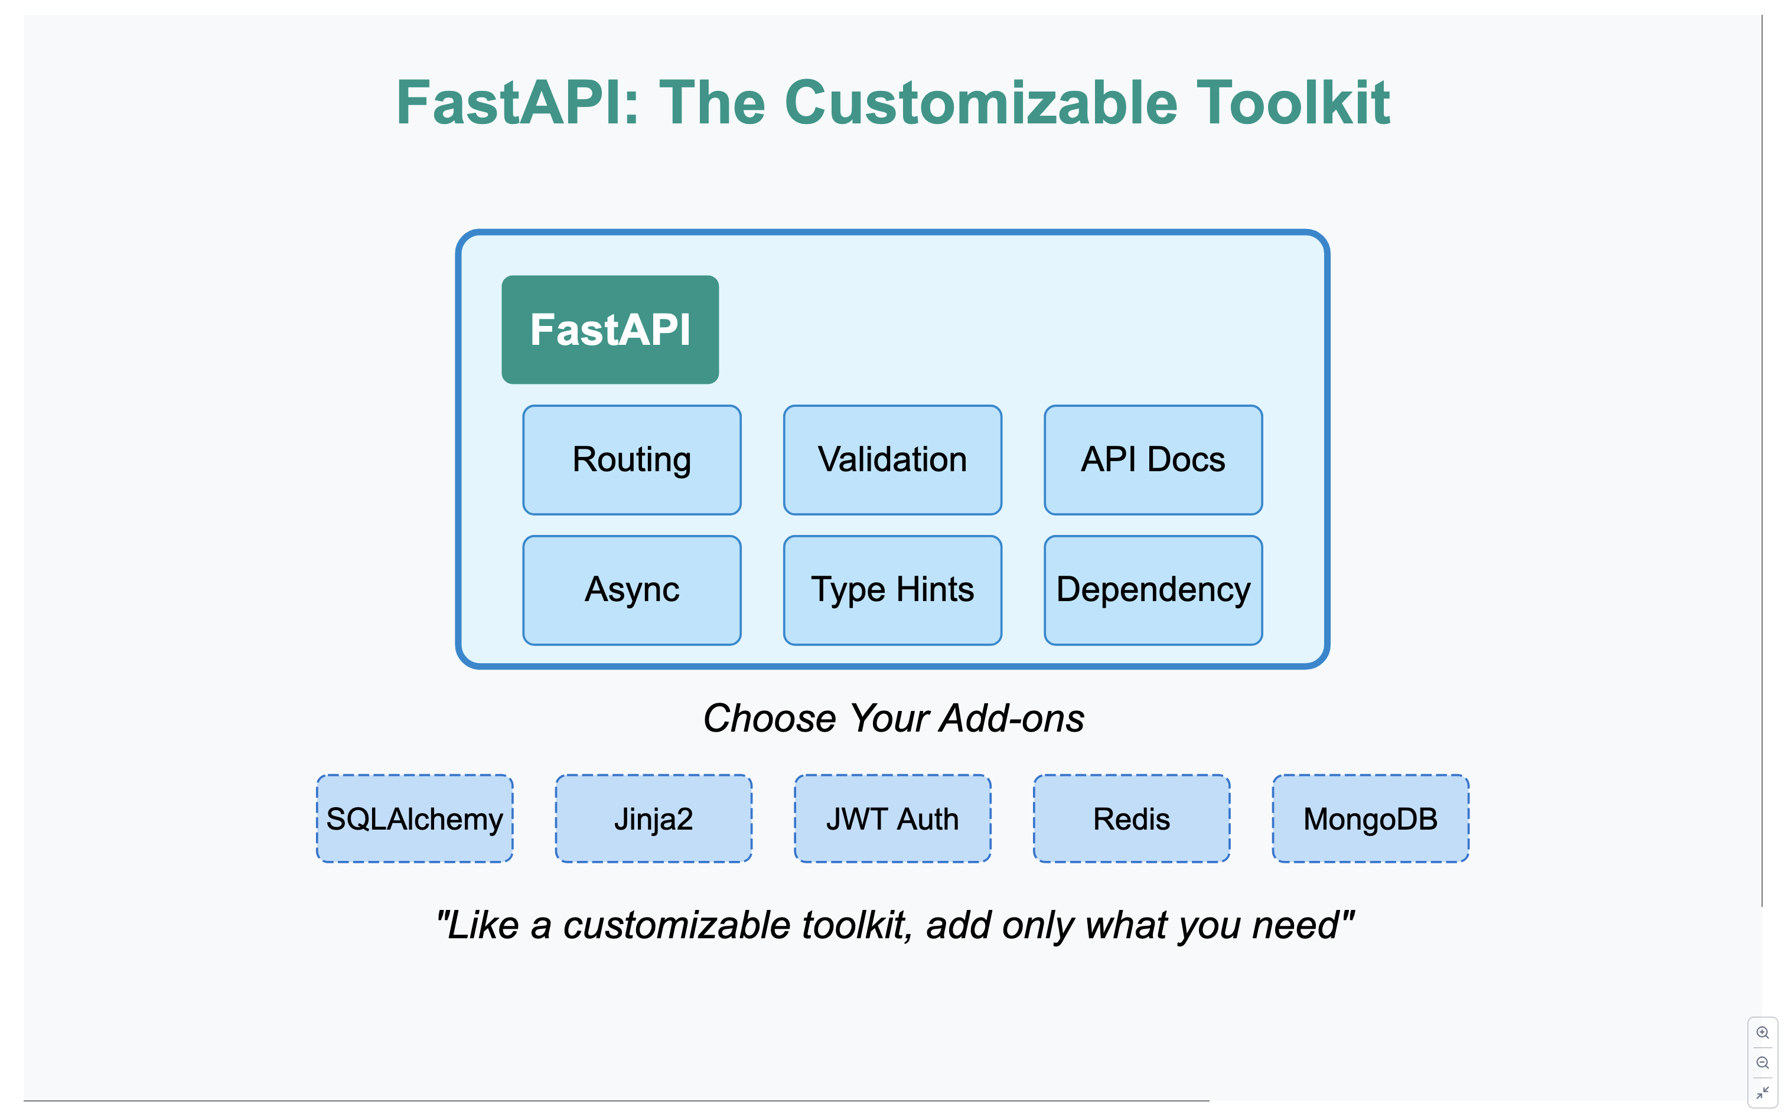
Notes:
"If Django is like a fully-furnished house where everything is included, FastAPI is more like a customizable toolkit where you select exactly the components you need for your specific project.
As you can see in this diagram, FastAPI provides a core set of essential tools - routing, validation, API documentation, async support, type hints, and dependency injection. These components are lightweight but powerful, giving you just what you need to build high-performance APIs.
Below the core components, you'll notice several optional add-ons. Unlike Django, which bundles everything together, FastAPI lets you choose your own database ORM, template engine, authentication system, and other components.
For example, if you need a database, you might add SQLAlchemy. If you need HTML templates, you can add Jinja2. Need authentication? Add a JWT library. The key difference from Django is that none of these are included by default - you build your stack based on your project's specific requirements.
This approach has several advantages: your application includes only what it needs, resulting in less overhead and better performance. It's also more flexible, allowing you to swap components as needed.
The trade-off, of course, is that you'll need to make more decisions and potentially integrate more pieces yourself. But for many developers, especially those building APIs, this flexibility is exactly what they want.
Next, let's look at how FastAPI's architecture works."

Slide 23
FastAPI Architecture

Slide 24
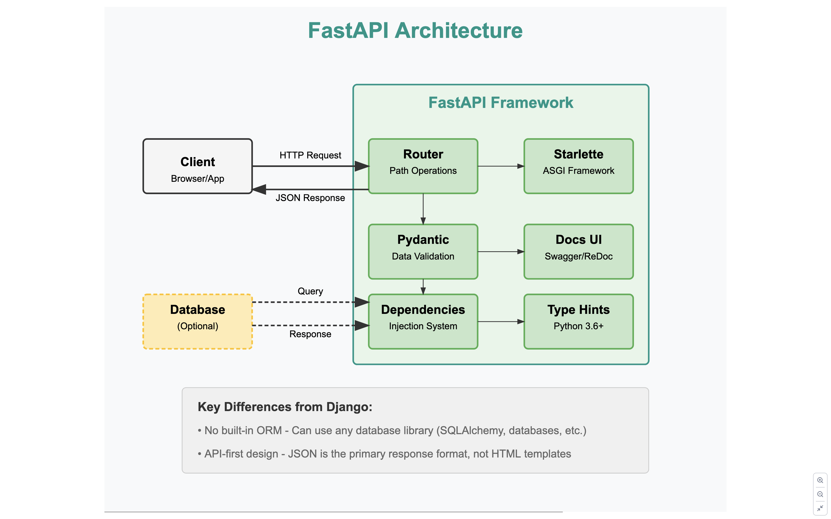
Notes:
"Now, let's explore FastAPI's architecture to understand how it differs from Django. As you can see in this diagram, FastAPI is built on a few key components that work together to deliver its high performance and developer-friendly features.
At the core of FastAPI is Starlette, a lightweight ASGI framework that enables asynchronous capabilities. This is a fundamental difference from Django, which uses WSGI and has only recently begun adding async support. The ASGI foundation is what allows FastAPI to handle more concurrent connections and achieve its impressive performance metrics.
The Router component handles path operations - essentially matching incoming requests to the appropriate function based on the URL path and HTTP method. This is similar to Django's URL dispatcher but with a more streamlined API.
For data validation, FastAPI uses Pydantic, a powerful data validation library that works with Python's type hints. This is one of FastAPI's standout features - when you define a parameter with a type annotation, FastAPI automatically validates incoming data against that type. This eliminates a lot of boilerplate validation code you'd have to write in other frameworks.
The Dependency Injection system is another powerful feature, allowing you to declare dependencies directly in function parameters. This makes it easy to share code for authentication, database connections, and other common needs.
FastAPI also includes built-in documentation UI through Swagger and ReDoc. This means your API's documentation is always up-to-date because it's generated directly from your code.
Notice that the database component is shown as optional with a dashed line. Unlike Django which includes its own ORM, FastAPI doesn't come with any database integration. You're free to use SQLAlchemy, tortoise-orm, databases, or any other database library.
Another key difference is that FastAPI is primarily designed for building APIs that return JSON, while Django is a full-stack framework that primarily returns HTML. FastAPI can work with HTML templates, but that's not its main focus.
In the next slide, we'll take a look at how a request flows through a FastAPI application."

Slide 25
FastAPI Request Flow

Slide 26
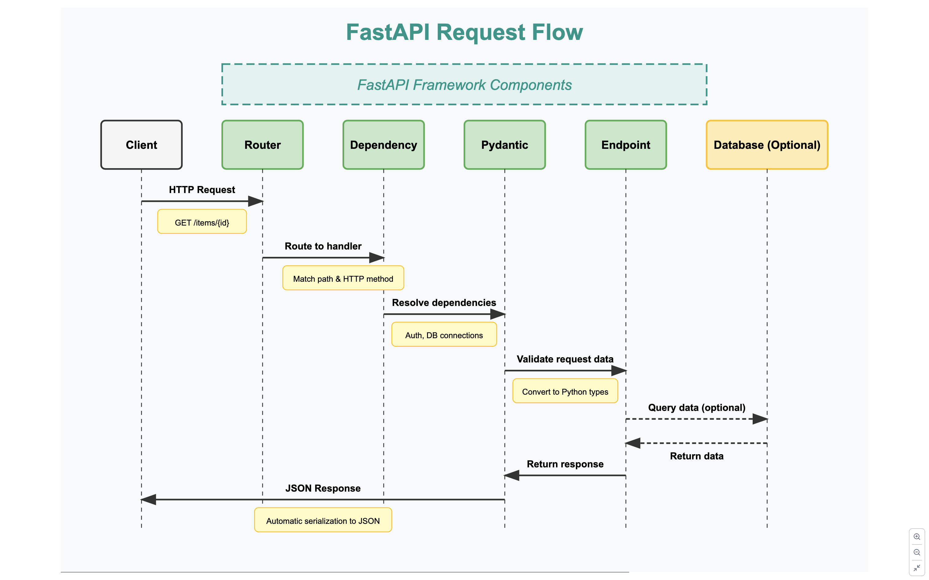
Notes:
"Let's walk through how a request flows through a FastAPI application to better understand its architecture in action.
When a client, like a browser or mobile app, sends an HTTP request to a FastAPI application, it first hits the Router component. The router examines the URL path and HTTP method to determine which handler function should process the request. For example, a GET request to '/items/42' might be routed to a function called 'get_item’.
Next, the Dependency Injection system resolves any dependencies declared in the handler function. Dependencies are a powerful FastAPI feature that allow you to inject common functionality like database connections or authentication. For instance, a function might declare that it needs a current_user dependency, which would verify that the request includes a valid authentication token.
After dependencies are resolved, the Pydantic component validates the incoming request data against the type hints in your function parameters. If your function expects an integer ID parameter and someone sends a string, FastAPI will automatically convert it or return an appropriate error response. This automatic validation saves you from writing lots of defensive code.
Once the data is validated, the actual endpoint function is executed. This is your application code that handles the business logic. If needed, this function might query a database or external service, though as we mentioned earlier, database access is optional and not built into FastAPI itself.
After your function completes its work, it returns a response object or a simple Python value. FastAPI then uses Pydantic again to convert this response to JSON before sending it back to the client. The conversion is automatic - you can return Python dictionaries, lists, or Pydantic models, and they'll be properly serialized to JSON.
Notice how the entire flow is more streamlined compared to Django. There's no template rendering by default (though you can add it if needed), and the focus is on processing JSON APIs efficiently. This laser focus on doing one thing extremely well is part of what makes FastAPI so performant.
Now, let's compare FastAPI and Django directly to see when you might choose one over the other."

Slide 27
Live Demo Comparison
Notes:
Pre-Demo Setup
Terminal Windows:
Left terminal: Django server running
Right terminal: FastAPI server running
Code Editors:
Left editor: Django project files
Right editor: FastAPI project files
Browser Windows:
Left tab: Django Todo app (http://127.0.0.1:8000/)
Right tab: FastAPI Todo app (http://127.0.0.1:8001/)
Numbered Flow Guide with Script
1. Introduction (1 minute)
"Now that we've covered the theoretical differences between Django and FastAPI, let's see them in action. I've created the exact same Todo application in both frameworks to demonstrate their different approaches to solving the same problem.
Both apps have identical functionality:
Adding new todo items
Toggling items as complete or incomplete
Deleting items
I've intentionally kept the implementation simple with in-memory storage instead of a database so we can focus on the framework differences rather than database connectivity."
2. Project Structure (2 minutes)
"First, let's look at how each project is structured.
Django follows a project/app structure. The project is 'django_todo' and it contains an app called 'todos'. This separation allows you to reuse apps across different projects. Each app has its specific responsibilities like models for data, views for logic, and urls for routing. Notice how Django separates these concerns into different files.
In contrast, FastAPI has a much flatter structure. Everything is defined in the main.py file – routes, handlers, and business logic. Templates are still in a separate folder, but the overall structure is significantly simpler."
3. Routing (2 minutes)
"Let's compare how each framework handles URL routing.
Django uses a URL dispatcher with separate URL configuration files. The main project urls.py includes the app's urls.py. Routes are defined as patterns that map to view functions.
FastAPI uses decorators to define routes directly on the handler functions. Notice how the HTTP method is part of the decorator (@app.get, @app.post), and how path parameters are defined right in the path string. FastAPI also supports modern Python features like type hints and async functions."
4. Request Handling (3 minutes)
"Now, let's see how each framework handles incoming requests.
Django views typically handle multiple actions in one function. This view is processing all three actions (add, toggle, delete) by checking the POST data. Django provides the request object that contains form data, session information, and more.
FastAPI separates concerns by having individual handler functions for each action. Notice how FastAPI uses type hints for automatic validation. If someone tries to pass an invalid parameter type, FastAPI will automatically return an error."
5. Templates (2 minutes)
"Both frameworks use HTML templates, but with slightly different approaches.
Django has its own template language with special tags and filters. Notice the {% csrf_token %} which provides security against cross-site request forgery attacks, and the {% url 'todo_list' %} tag that generates a URL based on the route name.
FastAPI uses Jinja2 templates which are similar but slightly different from Django's template language. Notice there's no CSRF token (you would need to add that manually), and URLs are hardcoded rather than generated from names."
6. Live Demo (3 minutes)
"Now let's see both applications in action. I'll perform the same operations in both apps so you can see that they function identically despite the different implementations.
Here are our two identical-looking Todo apps - Django on the left, FastAPI on the right.
I'll add a task to learn Django in the first app, and a task to learn FastAPI in the second app. Both apps handle the form submission, create a new todo item, and redirect back to the list view.
Now I'll mark a task as complete in both apps. See how both update the completion status and change the visual appearance of the completed item.
Finally, I'll delete an item from each list. Both apps remove the item without a full page reload."
7. Framework-Specific Features (3 minutes)
"Now let's look at some unique features that differentiate these frameworks.
Django comes with this powerful administrative interface built-in. With just a few lines of code, you get a complete CRUD interface for your data models. This is something FastAPI doesn't offer out of the box.
FastAPI automatically generates interactive API documentation. You can see all your endpoints, test them directly from the browser, and view the expected parameter types. This is incredibly useful for API development.
While we can't do a full benchmark now, it's worth noting that FastAPI is generally faster for API responses due to its async support and optimized routing. However, Django provides more built-in
features that would take time to implement in FastAPI."
8. Conclusion (1 minute)
"As you can see, both frameworks can achieve the same end result, but they take different approaches:
Django is comprehensive, including everything you need for a full-featured web application
FastAPI is specialized, focusing on high-performance APIs with modern Python features
For beginners, Django might be easier to start with because it makes many decisions for you. However, FastAPI provides more flexibility and is excellent for API-focused projects.
The best choice depends on your project's needs:
Building a content site, CMS, or admin-heavy application? Django shines here.
Building an API, microservice, or high-performance backend? FastAPI would be better.
Remember, understanding the concepts is more important than the specific framework. Once you understand web fundamentals, moving between frameworks becomes much easier."

Slide 28
Career Opportunities in the Philippines

Slide 29
Python Web Development Careers in the Philippines
Example Salary Ranges (From Job Listings):
Entry Level: ₱32,000 - ₱35,000/month (ASG Platform)
Mid-Level: ₱35,000 - ₱50,000/month (AI Fullstack)
Experienced: ₱50,000 - ₱80,000/month (Django & React)
Senior Positions: ₱120,000+ opportunities exist
Most In-Demand Skills:
Django: Enterprise, E-commerce, CMS
FastAPI: AI/ML applications, High-performance APIs
Common: PostgreSQL, Docker, Git, React
Notes:
Now that we've seen both frameworks in action, let's look at the career opportunities they can open up for you. Python web developers are in high demand in the Philippines, with competitive salaries across experience levels.
Looking at the job listings I've collected, we can see some real salary examples in the current market. Entry-level positions at companies like ASG Platform start around ₱32,000 to ₱35,000 per month. Mid-level AI development roles offer about ₱35,000 to ₱50,000, while experienced full-stack developers working with Django and React can earn ₱50,000 to ₱80,000 per month. For senior specialists, there are opportunities exceeding ₱120,000 monthly.
There's some specialization in the job market: Django is particularly popular for enterprise applications, e-commerce, and content management systems, while FastAPI is frequently requested for AI/ML applications and high-performance APIs. Regardless of which framework you focus on, skills in PostgreSQL, Docker, Git, and frontend technologies like React are consistently in demand.

Slide 30
Python Framework Job Market Insights
Companies Hiring:
Multinational: Accenture, IBM, CITCO, Amdocs
Local: PayMaya, GCash, Various startups
Entry Points:
Fresh Graduate Programs (₱25K-₱35K)
2-Year Residency Programs (₱32K-₱35K → ₱100K)
Junior Developer Roles (₱30K-₱45K)
Career Growth Factors:
Framework specialization (+20-30% salary premium)
DevOps knowledge (Docker, CI/CD)
Full-stack capabilities (React, Vue.js)

Slide 31
Job Market Data Sources (JobStreet Listings)
Django Jobs:
Full-Stack Developer (Django & React) – Remote - Roko Home Services
Full Stack Engineer - CITCO International Support Services
Entry-Level Opportunities:
Software Engineer - Fresh Graduates Accepted! - Amdocs Philippines Inc.
(WFH) Software Developers - 2 Year Residency Program - ASG Platform
AI & Python Jobs:
Artificial Intelligence Developers - Offshore Outsource Operations, Inc.
Salary Research:
₱120,000+ Salary Range for FastAPI Engineers
Notes:
All the job market data I've presented comes from actual job listings currently available on JobStreet. These positions range from entry-level opportunities for fresh graduates to specialized roles requiring several years of experience.
For Django developers, there are opportunities like the Full-Stack position at Roko Home Services combining Django with React, and the Full Stack Engineer role at CITCO International.
If you're just starting out, companies like Amdocs Philippines have programs specifically for fresh graduates, while ASG Platform offers a 2-year residency program that includes training while earning.
For those interested in AI development, companies like Offshore Outsource Operations are hiring developers with Python framework experience.
My salary data comes from these listings as well as JobStreet's salary range filter showing FastAPI positions offering ₱120,000+ monthly.
I encourage you to explore these opportunities on job platforms to get a better understanding of current market requirements and compensation.

Slide 32
Which Framework Should You Choose?

Slide 33
Which Framework Should You Choose?
Choose Django When:
Building complete websites with user accounts, admin panels
Need built-in features like authentication, admin panel, forms
Creating content-heavy sites (blogs, e-commerce, social media)
Want a "batteries-included" approach (like a fully furnished house)
Choose FastAPI When:
Building APIs for mobile apps or frontend frameworks
Performance is critical
Need automatic API documentation
Prefer a lightweight, modern approach (like a custom tiny home)
Notes:
Let's talk about which framework you should choose. Both Django and FastAPI are excellent options, but they excel in different situations.
Choose Django when you're building a complete website that needs user accounts, admin panels, and lots of features working together. Django is like getting a fully furnished house - everything you need is already included! It's perfect for content-heavy sites like blogs, online stores, or social media platforms.
On the other hand, choose FastAPI when you're primarily building an API for mobile apps or modern JavaScript frameworks. FastAPI is incredibly fast and automatically generates documentation for your API. It's like building a custom tiny home - minimalist, modern, and highly efficient.

Slide 34
Recommendations for Beginners
For Complete Beginners: Start with Django (more structure, tutorials)
For AI/Data Science Interest: Consider FastAPI (popular for ML APIs)
The Good News:
Both are in high demand in the Philippines
Skills from one transfer to the other
You can (and should) eventually learn both!
Most Important: Just start building something!
Notes:
If you're brand new to web development, Django might be easier to start with because it gives you more structure and has tons of tutorials available online. If you're interested in AI or data science, FastAPI might be more relevant since it's commonly used to create APIs for machine learning models.
Here's the good news: both frameworks are in high demand in the Philippines, as we saw in the previous section. Even better, once you learn one Python web framework, picking up the other becomes much easier because many concepts transfer between them.
Remember, this doesn't have to be an either/or decision - many professional developers know both frameworks and use them for different types of projects.
The most important advice I can give you is to just start building something! You'll learn so much more by creating a simple project than by spending too long deciding which framework to use first. Pick one that seems interesting to you and dive in!

Slide 35
Resources & Getting Started

Slide 36
Resources & Getting Started
Official Documentation:
Django: https://docs.djangoproject.com/
FastAPI: https://fastapi.tiangolo.com/
Beginner-Friendly Tutorials:
Django: Django Girls Tutorial,
Mozilla Django Tutorial FastAPI: FastAPI's Interactive Docs,
TestDriven.io guides
freeCodeCamp.org Certifications: (Highly Recommended!)
Practice Projects:
Todo App (like our demo!)
Personal Blog
Simple API for a mobile app
GitHub Repository: https://github.com/jeryldev/python-web-frameworks-2025
Notes:
Before we wrap up and move to Q&A, I want to leave you with some resources to continue your learning journey.
Both frameworks have excellent official documentation. Django's docs are comprehensive and well-organized, while FastAPI's documentation is interactive and includes lots of code examples.
For beginners, I highly recommend the Django Girls Tutorial, which is designed specifically for newcomers to programming. The Mozilla Django Tutorial is also excellent and takes you through building a complete library management system. For FastAPI, the official interactive documentation is surprisingly beginner-friendly, and TestDriven.io offers some great tutorials as well.
I want to especially highlight freeCodeCamp's Full Stack Developer Certification. This is an incredible, completely free resource that I personally completed in May 2020, which directly helped me land my first junior software engineer role at PDAX just seven months later. If you start now while still in college, you'll have a significant advantage when applying for entry-level positions after graduation. The curriculum covers everything from HTML and CSS to JavaScript, React, Node.js, and database technologies - skills that complement what you'll learn with Django or FastAPI.
When you're ready to practice, start with simple projects like the Todo app we demonstrated today. A personal blog is another great project for Django, while a simple API for a mobile app is perfect for practicing FastAPI.
All the code from today's demos is available in the GitHub repository linked on this slide. You'll find both the Django and FastAPI implementations of the Todo app, along with setup instructions to run them locally.
Remember, the key to learning programming is practice. Don't worry about building something perfect - focus on building something that works, then improve it as you learn more. Feel free to reach out if you have questions as you start your web development journey!

Slide 37
Q&A

